Slide 1

Circular Queue
Presented by:
Elizer Ponio Jr.
Department of Computer Science
College of Computing and Information Technologies

Slide 2
Outline
What is a Circular Queue?
Queue Operations
Implementations of a Queue
Applications of a Queue
Notes:
Have you asked yourself the question, why do people organize?
Lets go to the psychology of organizing
This predictability applies within the context of our homes, manifesting through the concept of organization

Slide 3
What is a Circular Queue?
A circular queue is the extended version of a regular queue where the last element is connected to the first element forming a circle-like structure.
Notes:
Have you asked yourself the question, why do people organize?
Lets go to the psychology of organizing
This predictability applies within the context of our homes, manifesting through the concept of organization

Slide 4

What is a Queue?
Circular Queue Operations
Notes:
Have you asked yourself the question, why do people organize?
Lets go to the psychology of organizing
This predictability applies within the context of our homes, manifesting through the concept of organization

Slide 5
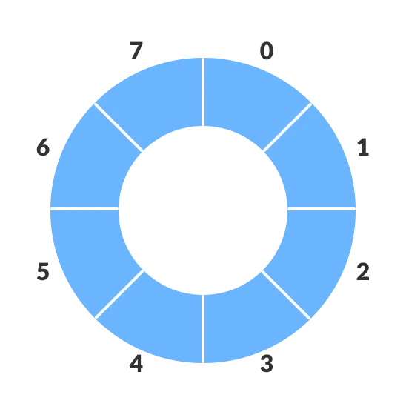
What is a Circular Queue?
Notes:
Have you asked yourself the question, why do people organize?
Lets go to the psychology of organizing
This predictability applies within the context of our homes, manifesting through the concept of organization

Slide 6

0 | 1 | 2 | 3
John
Jack
Jimmy
Jane
Front
Rear
Front
John
Jack
enqueue(“John”)
enqueue(“Jack”)
enqueue(“Jimmy”)
enqueue(“Jane”)
Jane
Jimmy
Rear
Notes:
Have you asked yourself the question, why do people organize?
Lets go to the psychology of organizing
This predictability applies within the context of our homes, manifesting through the concept of organization

Slide 7
0 | 1 | 2 | 3
John
Jack
Jimmy
Jane
Front
Front
Front
Rear
Front
Front
John
Jack
dequeue()
dequeue()
Jane
Jimmy
Rear
Front
Notes:
Have you asked yourself the question, why do people organize?
Lets go to the psychology of organizing
This predictability applies within the context of our homes, manifesting through the concept of organization

Slide 8
0 | 1 | 2 | 3
Elizer
Robert
Jimmy
Jane
Rear
Rear
Front
Rear
Rear
Rear
Elizer
Robert
enqueue(“Elizer”)
enqueue(“Robert”)
Jane
Jimmy
Front
Rear
Notes:
Have you asked yourself the question, why do people organize?
Lets go to the psychology of organizing
This predictability applies within the context of our homes, manifesting through the concept of organization

